Slide 1

Fraud detection models and trust level validation in MMT
Final Presentation
Xi He and Yangxin Fan
05/17/2021

Slide 2
Motivation & Social Impact
Recently, mobile money service has been increasingly popular since it is convenient
Financial deception in mobile money transaction is a big issue. A study in 2020 shows that an increase of almost 35% in fraud attempts in mobile money transaction during COVID-19 pandemic [3]
Machine learning models have shown promising results for classification problems and fraud detection problems.
Create a software system to select the best machine learning models, perform functional validation process, and assign trust levels.

Slide 3
Problem Statement
Goal: develop a service agent AI software which can select k best machine learning models, validate the functionality of selected models, and assign trust levels for mobile money transaction.
Potential implementation: our model can help RIG to provide accurate and verified predictive models to detect fraud and assign trust level for future mobile money transaction.

Slide 4
Dataset:
Synthetic Financial Datasets For Fraud Detection generated by PaySim mobile money simulator from Kaggle [1]
This dataset has been constructed using real transaction data and also have a few fraudulent transactions inserted into them.
6,362,620 observations and 12 features after data preprocessing
Issue: huge imbalance present in the actual data: The dataset is highly unbalanced. 0: no fraud >> 1: fraud (only 0.1291% are fraud) which makes it even harder to train any models for fraud detection
Solution: Oversample the fraud cases to balance the dataset

Slide 5
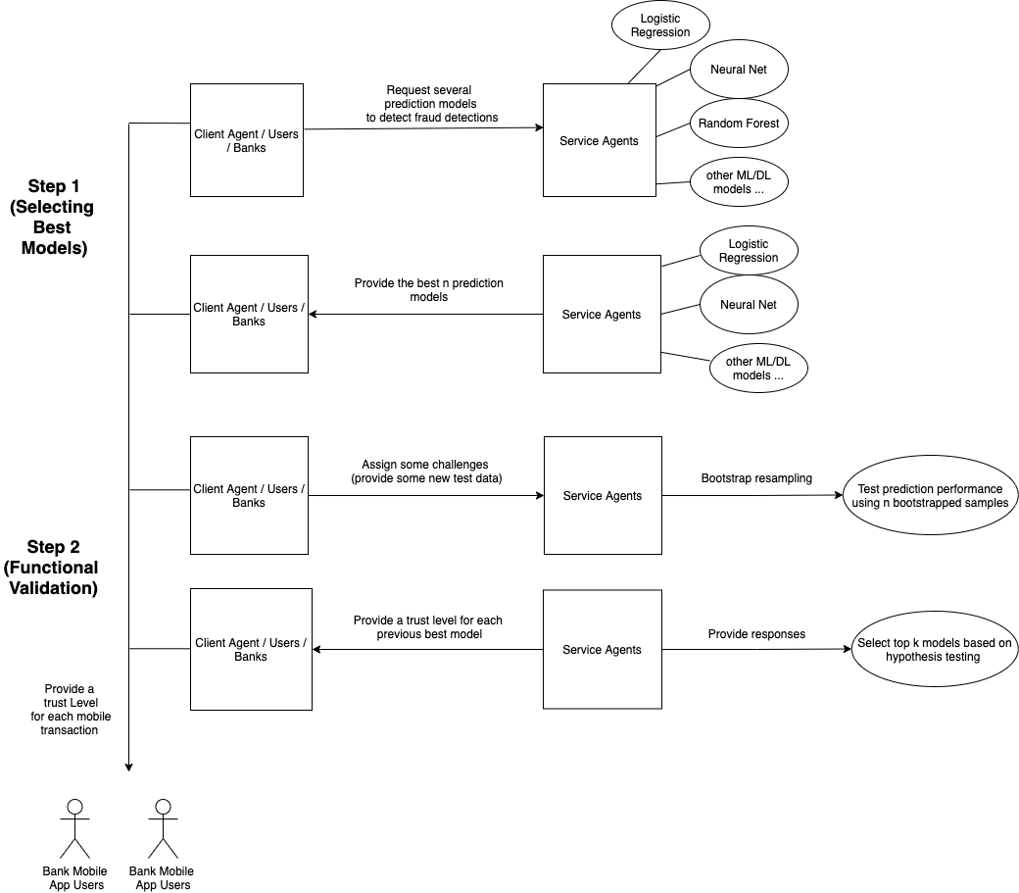
Architecture
In step 1, our system trains multiple ML models using data provided by clients and choose top k models based on test dataset performance
In step 2, clients provide new labeled data to service agents, our system uses bootstrap resampling to generate N different test datasets. It then use hypothesis testing to validate whether previously observed model performance is trustworthy or not. Our system also assigns trust level to new transactions based on their probability to be fraudulent.

Slide 6

Model Selection
Goal: A fraud detection module that can select top k machine learning models to predict fraud transactions
Constructed 7 Machine Learning models: Linear SVMs, Logistic Regression, Neural Networks, Random Forests, Gradient Boosting, AdaBoost, Naive Bayes Classifier
Best models: Random Forests, Gradient Boosting, AdaBoost

Slide 7
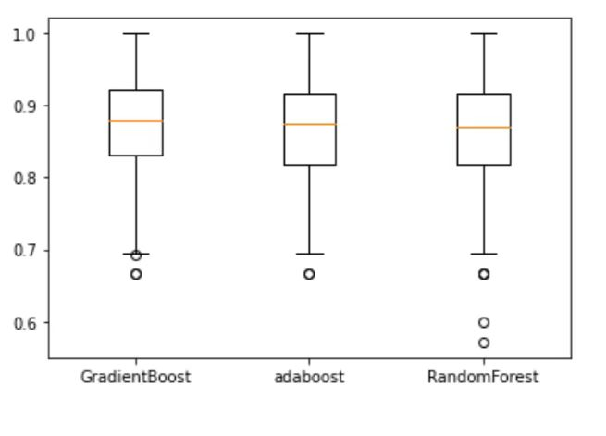
Functional validation (bootstrapping)
Method: Bootstrap is a resampling method, i.e: random sampling process with replacement.
Goal: We want to use it to generate many different test challenges based one single labeled test dataset provided by clients.
We calculate the sample mean of model F1 score and sample variance of model F1 score, which are used in the following hypothesis tests.
Boxplot of F1 score from Bootstrapped datasets of top three best models

Slide 8
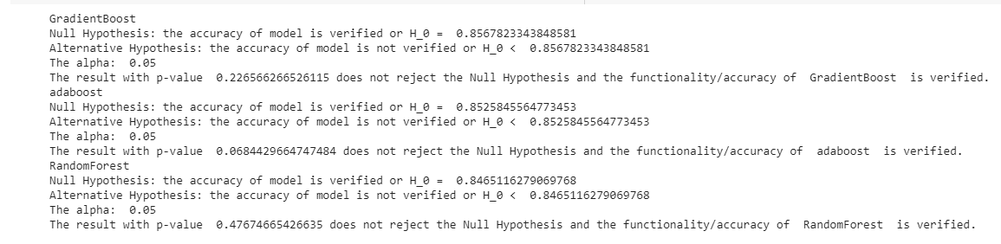
Functional validation (hypothesis test)
Null: The accuracy/F1 score of the model is verified. (mean_service = mean_client)
Alternative: The accuracy/F1 score of the model is not verified (mean_client < mean_service)
Goal: We apply t-tests to validate model accuracy/F1 score.
The purpose of functional validation is to check its accuracy on bootstrapped datasets
(resampled from “challenges” given by clients) perform as well as it did in previous Service
module. See t-test results of top 3 models below

Slide 9
Dynamic Trust
Goal: Give a trust level (1-5) for each mobile money transaction sample to show the risk / safety of each mobile money transaction
Use previous best and verified machine learning models to make prediction
Machine learning models can predict the probability that a mobile money transaction sample is fraudulent
0.8<=Probability <=1
0.6<=Probability < 0.8
0.4<=Probability < 0.6
0.2<=Probability < 0.4
0.0<=Probability < 0.2
Trust Level 1
Trust Level 2
Trust Level 3
Trust Level 4
Trust Level 5

Slide 10
Dynamic Trust
0<=combined value <=3
3<combined value <=6
6<combined value <=9
9<combined value <=12
12<combined value <=15
Trust Level 1
Trust Level 2
Trust Level 3
Trust Level 4
The distribution of trust level prediction is skewed
Using ensemble method to improve prediction accuracy: combine the results from random forest, adaboost, gradient boost together.
Trust Level 5
Random Forest | Adaboost | Gradient Boost | Combined Value | Final Trust Level
Trust Level 1 | Trust Level 2 | Trust Level 3 | 1+2+3=6 | Trust level 2
Trust Level 5 | Trust Level 3 | Trust Level 5 | 5+3+5=13 | Trust level 5

Slide 11
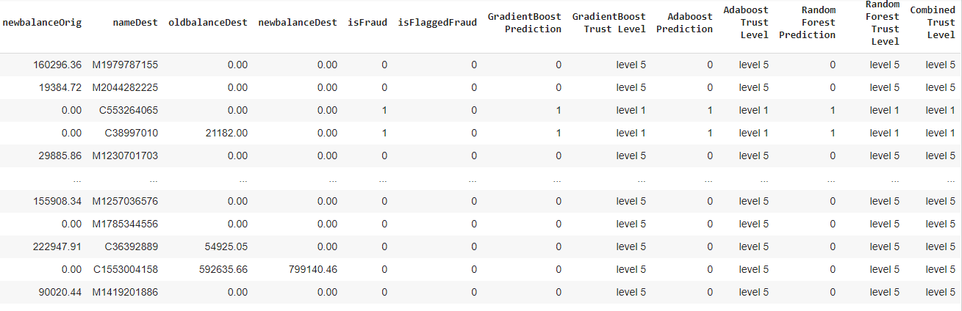
Final Result
1: Fraud 0: Non-Fraud
Combined Trust Level: The average trust level made by three best and verified models

Slide 12
Benefits of the service agent
Seven different Machine Learning algorithms for RIG to select from
Service agent as a Python class for easy reusability and integration in RIG’s dynamic trust service in MMT
Use analytics engine Spark can help future RIG interns to shorten model training time when developing more complex systems
Creative Bootstrapping based functional validation to help RIG’s clients use less data to generate more insights
Ensemble dynamic trust decision to bring more trustworthy trust level assignments for RIG’s clients

Slide 13
Potential Future Work
Finish the final report by the end of this week
build a better/more complex deep learning models
Build a visualization dashboard to better visualize the result and provide business insights for customers/companies
Dynamically improve the models/assign trust levels

Slide 14
References:
https://www.kaggle.com/ntnu-testimon/paysim1
https://www.forbes.com/sites/thomasbrewster/2019/03/27/millions-are-being-lost-to-apple-pay-fraudwill-apple-card-come-to-the-rescue/?sh=5ef7d46f622f
https://www.prnewswire.com/news-releases/study-digital-payments-fraud-surges-during-pandemic-301155991.html

